Slide 1


YOUTUBE SONG ANALYSIS WITH POWER BI
PRESENTED BY
BONI ACOBE ANGE ULRICH -- MIP-DA-10

Slide 2
CONTENT
01
04
Problem
Project Objectives
02
About Dataset
05
Analysis
03
06
Analysis Tools
Recommandation
1

Slide 3

PROBLEM
This internship project focuses on analyzing YouTube songs data using Power BI. The dataset includes attributes like video ID, channel title, title, description, tags, published date, view count, like count, favorite count, comment count, video duration, video definition, and caption details. The objective is to create insightful visualizations and reports to understand the performance, popularity, and user engagement of YouTube songs. The analysis aims to uncover trends, preferences, and patterns to help content creators and stakeholders optimize their YouTube song content.
2

Slide 4
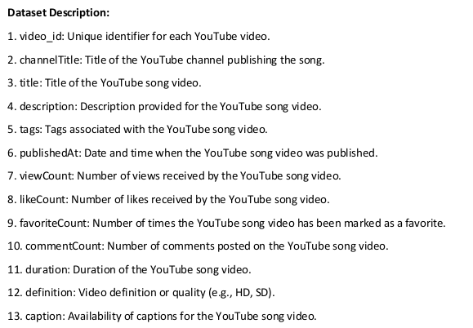
ABOUT DATASET
3

Slide 5

ANALYSIS TOOLS
Power BI is a business analytics tool developed by Microsoft that allows users to visualize and share insights from their data. It offers interactive dashboards, customizable reports, and advanced data visualization capabilities. Power BI connects to various data sources, enabling users to create data-driven insights and make informed business decisions.
4

Slide 6
PROJECT OBJECTIVES
Content and Channel Analysis
Temporal Trends
User Engagement Insights
5

Slide 7
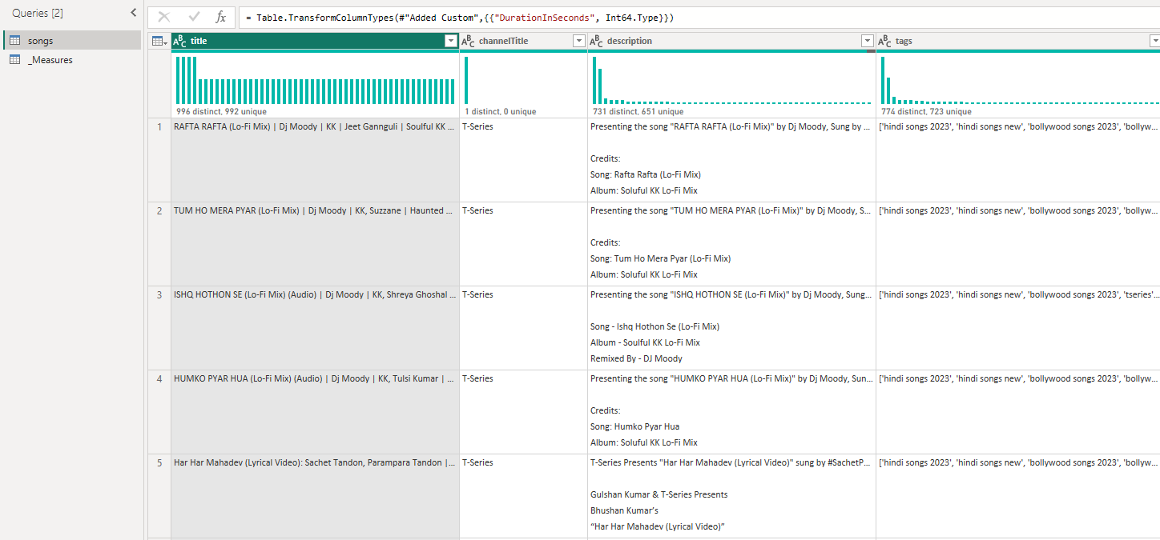
ANALYSIS
6

Slide 8
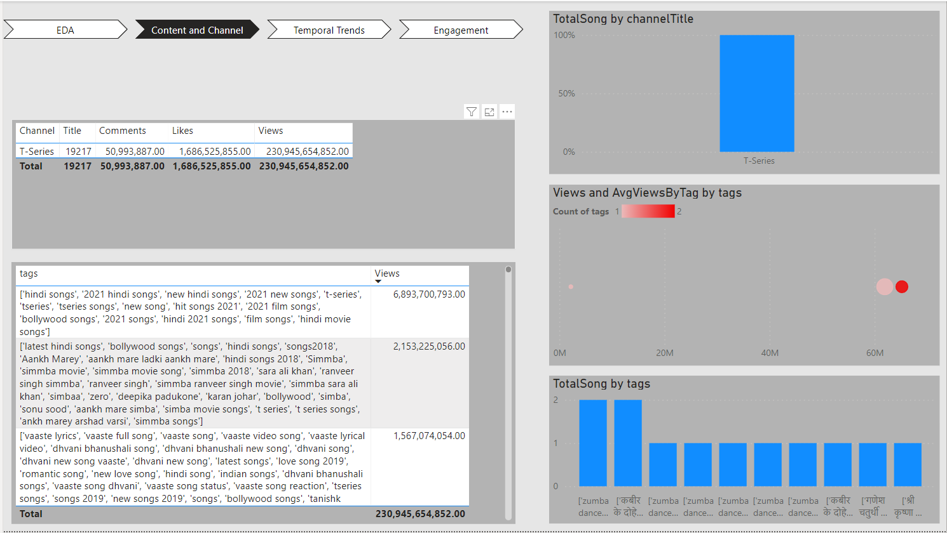
ANALYSIS
Content and Channel Analysis
7

Slide 9
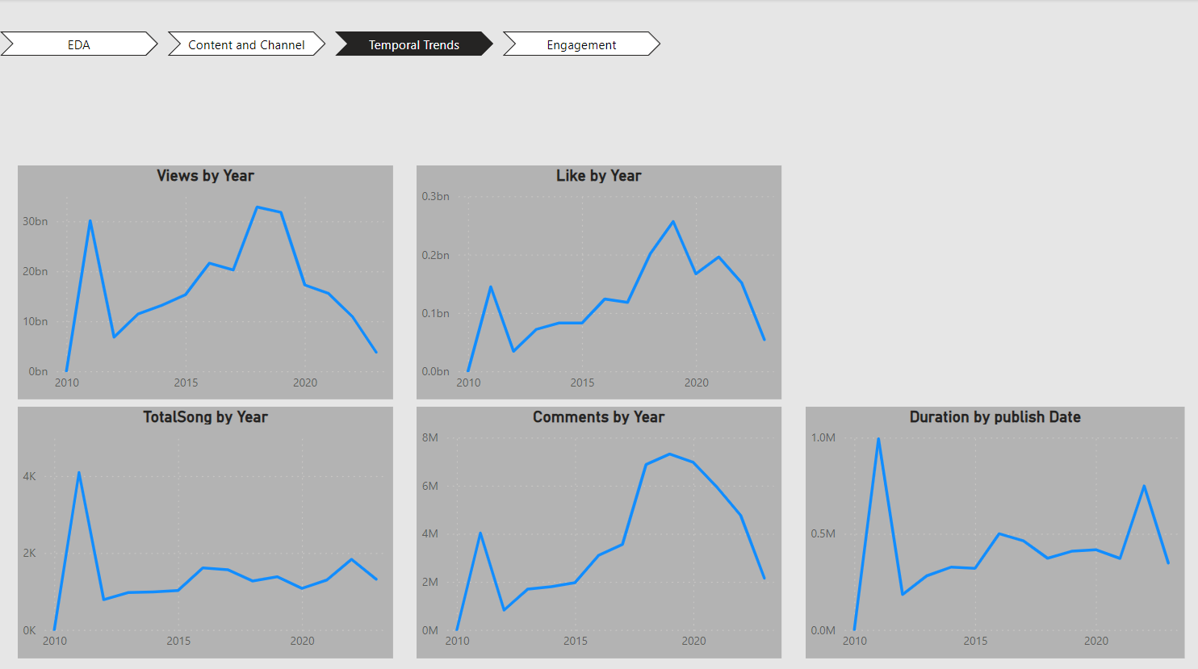
ANALYSIS
Temporal Trends
8

Slide 10
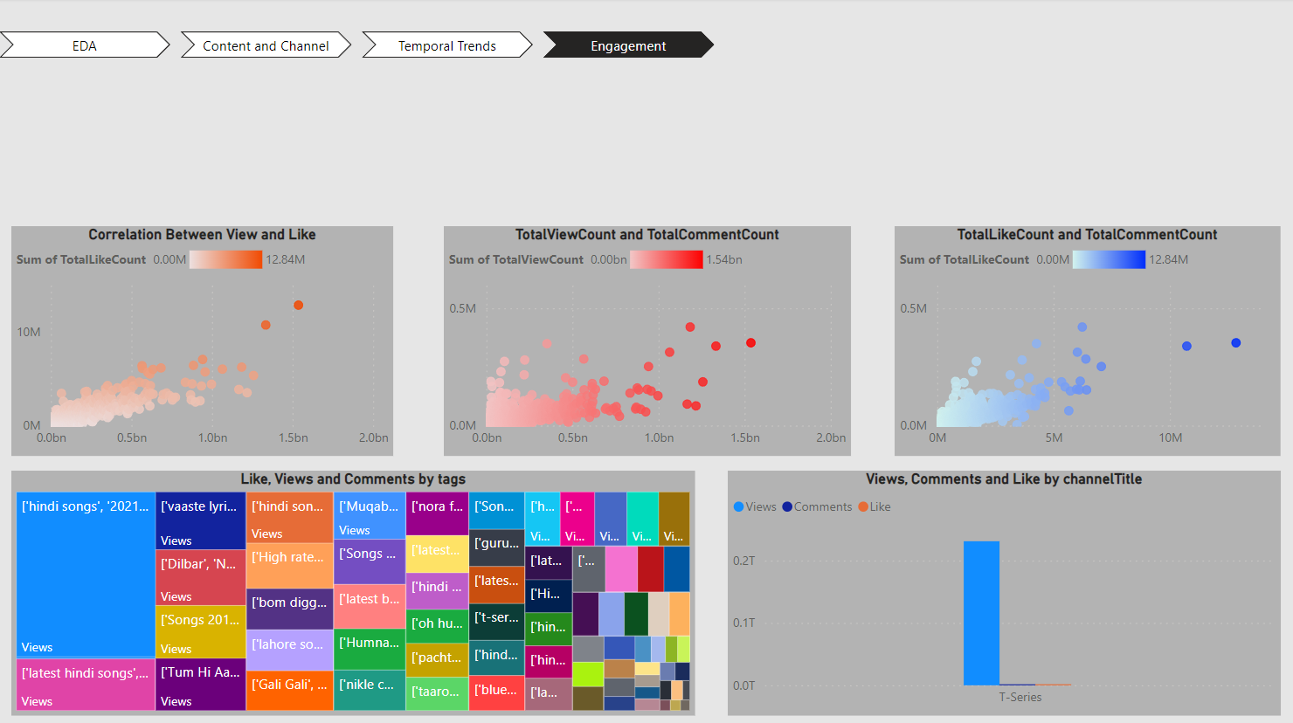
ANALYSIS
User Engagement and Insights
9

Slide 11
RECOMMANDATION
We can advise youtubers to post shorter videos (under 10 min) in HD quality. Because these days, nobody likes videos with a degraded display.
10

